Slide 1
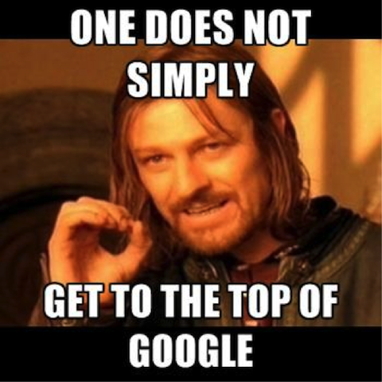
SEO Training
Go Here: jennymunn.com/seo-bootcamp-templates/
Jenny Munn
SEO Consultant/Trainer www.JennyMunn.com Jenny@JennyMunn.com Twitter @JennyMunn

Slide 2
Agenda
SEO Fundamentals
10:00-10:30am: Welcome & SEO Overview
10:30am – 11:00am: Keyword Research
11:00 – 11:30: Google Analytics
10-Minute Break: Stretch, Snack, Bathroom, Email Check Only if Necessary
Execution
11:40-12:30: On-Page Optimization: SEO Copywriting and SEO Blogging
12:30-1:00: Linkbuilding/Social Media Signals
5-Minute Break: Snack, Bathroom, Email Check Only if Necessary
SEO Recap
1:05-1:30: Organization and Recap (Hands On if Time)
1:30-2:00: FAQs
Ready for the fun?

Slide 3
Goals for This Training
Not an SEO expert – but more educated, empowered, aware VA
Understand how the activities you do impacts SEO website traffic and digital results so you can provide more value and ROI in this realm

Slide 4
Introduce Yourself – 30 Seconds
Name
Where do you live
How does SEO relate to you?
Biggest SEO challenge/SEO Question

Slide 5
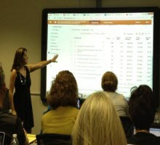
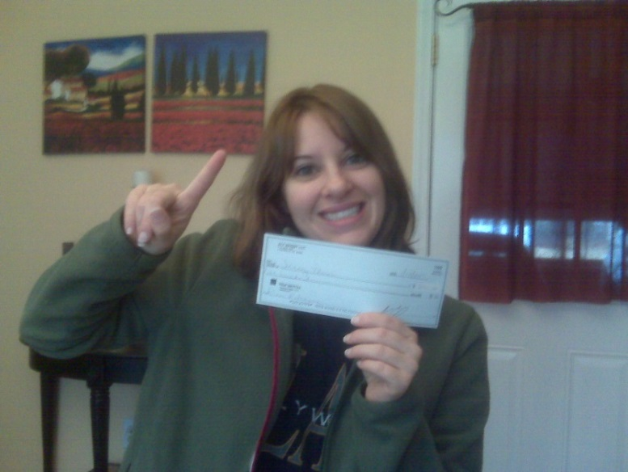
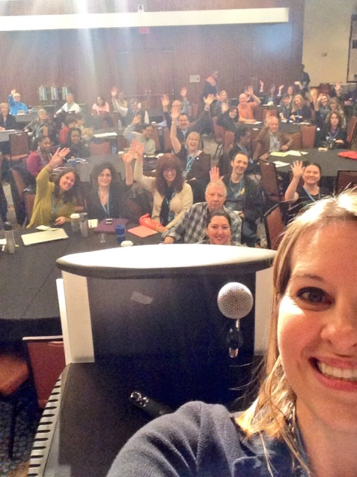
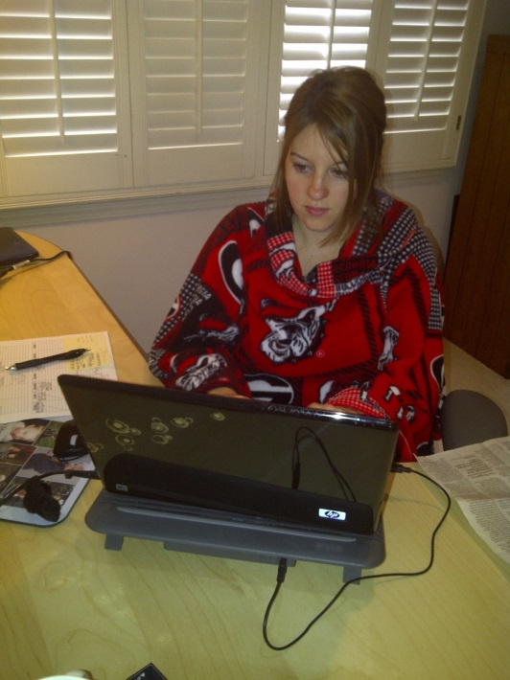
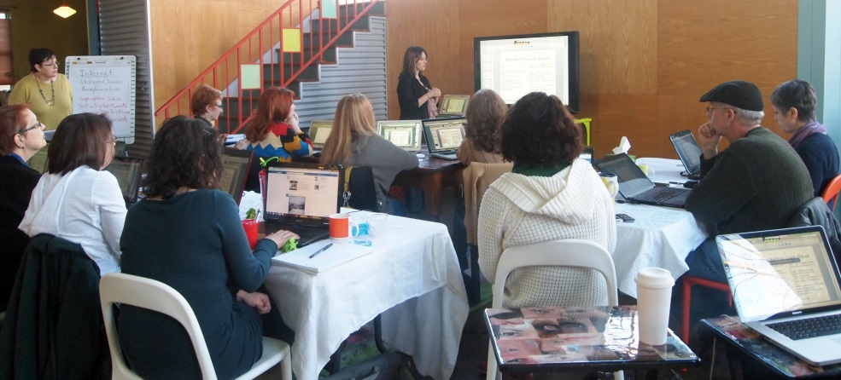
Jenny Munn - Who Am I?
2009
Newbie Freelance Copywriter trying to make it
2015: SEO Strategy, Training, Consulting

Slide 6
Brief Overview of SEO

Slide 7
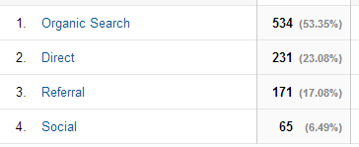
Diversification is Crucial

Slide 8
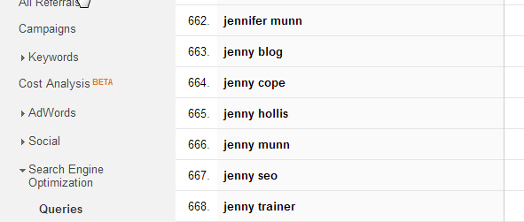
What is SEO?

Slide 9
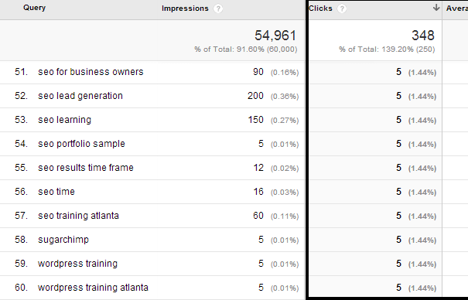
Average Position & “Clicks” On Your Website

Slide 10
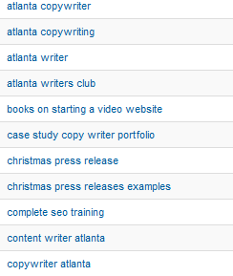
How Do I Know If My SEO Is Working? Enter Google Analytics
Notes:
-ultimately, you’ll know if your SEO was working if you get more sales.
-the thing about SEO is that it takes time; once you optimize your page, you have to wait around for Google to come back and index your site
-and just because you optimize your site, you’re not guaranteed to go up in rankings. It depends on WHO is ahead of you – what (that’s why your keywords are so important). If you choose extremely competitive, 1-2 word phrases you’re never going to beat Wikipedia and other really big sites with millions of dollars thrown at SEO out there.
-you won’t know if SEO is working until you try it. For me, it has been more than worth it as I get numerous opportunities that come my way because people find my website that way.

Slide 11
SEO Overview
SEO = Improving the Discovery of CONTENT
Important Basics About SEO
Marketing 101 = Using the language of your customers
Google ranks webPAGES…not a webSITE
Keywords are the absolute foundation of SEO
SEO does NOT happen on accident
The real goal of SEO: not just rankings, but traffic and conversions

Slide 12
What is SEO
The practice of making content findable
Google is not magic…SEO drives traffic – but the WEBSITE must convert the traffic into leads
Notes:
The real goal of SEO: not just rankings, but traffic and conversions

Slide 13
History
Of “Traditional” SEO

Slide 14
History of SEO
SEO used to be about going down a checklist of technical “to do’s”
Historically a very technical discipline
The industry is overrun with shady professionals who “guarantee” 1st place rankings
HUH?!
Canonical Tags…
“rel=”nofollow”
Meta Tags
Geo-Targeting
Robots.txt
XML Sitemaps
<head> tag
Panda Update
Jenny Munn
Notes:
The problem is that SEO has managed to get something of a bad name for itself over the past few years

Slide 15
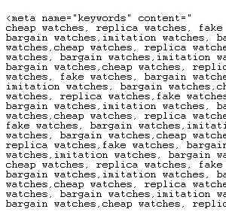
History of SEO: Once Upon a Time
Once upon a time there was a story of:
Meta tag keyword overload

Slide 16
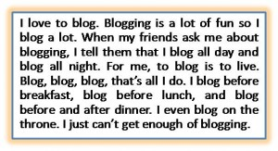
History of SEO: Once Upon a Time
Then came: using random words all over and targeting the same keyword repeatedly to make sure Google got the point

Slide 17
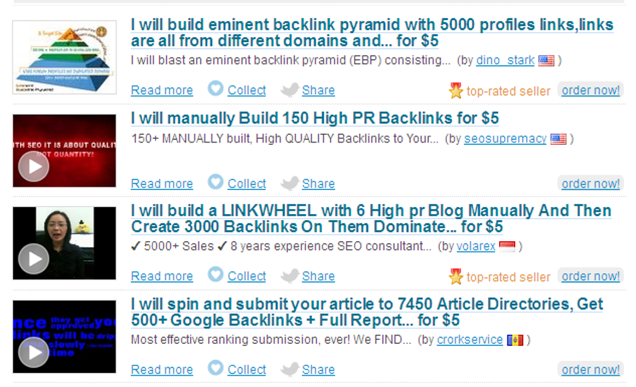
History of SEO: Once Upon a Time
Then, when that stopped working, came “linkbuilding”

Slide 18
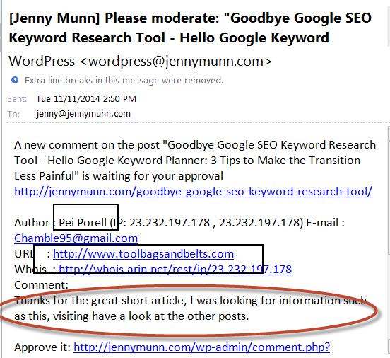
History of SEO: Once Upon a Time
Spammy Blog Commenting…

Slide 19
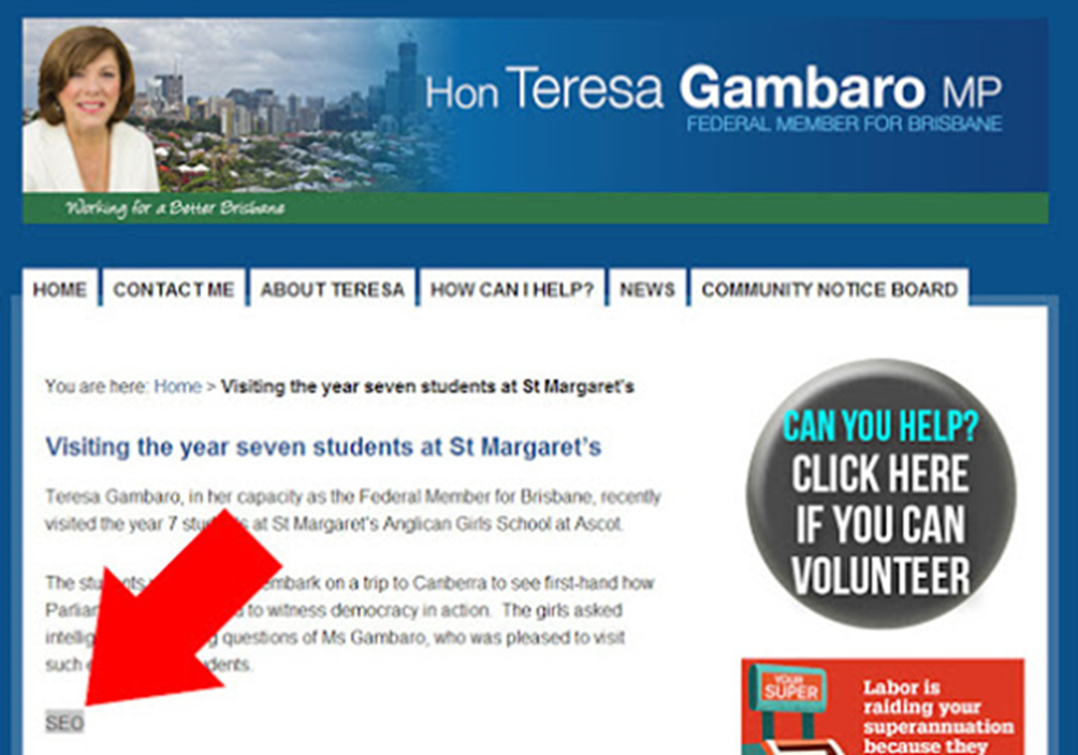
History of SEO: Once Upon a Time
Then, when that stopped working, came “linkbuilding”

Slide 20
History of SEO: Once Upon a Time
Finally, Google came in and put the smack down on nonsensical tactics

Slide 21
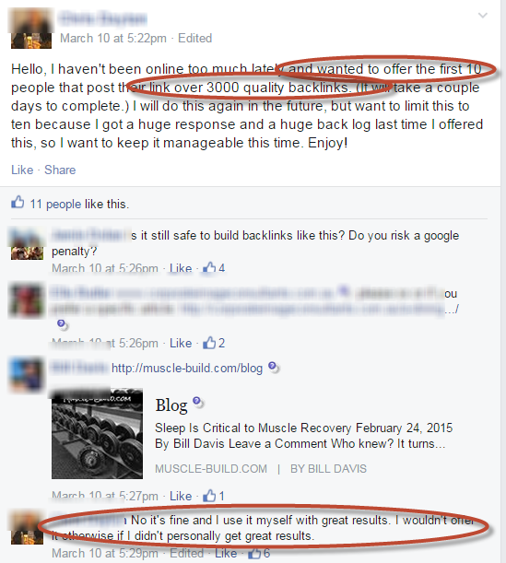
History of SEO: Once Upon a Time

Slide 23
“Traditional”SEO Is Out… Back to the Basics
are IN
SEO is simpler than ever, but not easy. This is due to the mesh of activities and disciplines that need to come together in order to realize long-term, sustainable success

Slide 24
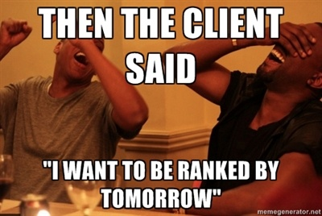
What Contributes to Successful SEO/Ranking:
Keyword Targeting
Technical SEO
Engagement
On-Page Optimization
Ongoing Content
Social Media
Conversion
Local SEO
Linkbuilding
Authority and Trust Signals

Slide 25
Keyword Research:
The foundation of your SEO efforts

Slide 26
Keyword Research Goals
Open up your world to the keyword possibilities
Endless choices – always “more and better”
Run-through of using a free keyword research tool and the importance of it
Getting to the ultimate deliverable – a “Master Keyword” spreadsheet

Slide 27
Phase 1: Brainstorm Keyword Possibilities
SEO Home base: Open up Excel
Brain Dump: Brainstorm ALL the words you think you should rank
Add to that list:
Google Autosuggest
Poll a partner
Poll your customers
Get a good solid list – and let’s VERIFY these words
Exercise- http://www.strategicvirtualsolutions.net/

Slide 28
Braindump keywords
http://www.strategicvirtualsolutions.net/

Slide 29
Keyword Research Tips
Group Like Words Together … Put In As Many As You Can Think Of
Horsinality:
Disconnect:
“horse training” vs “natural horsemanship”
Tips:
*don’t forget plurals *don’t forget synonyms *person, product or service?
“Love coach” or…
Dating coach
Matchmaker
Matchmaking professional
Dating coaches
Matchmaking for men
“Meeting Concierge” Or...
Meeting planner
Conference organizer
Independent meeting planner
Freelance meeting planner
Event coordinator
park city utah fly fishing
park city fly fishing
park city utah trout fishing
park city trout fishing
service, guide, excursion, activity, etc.

Slide 30
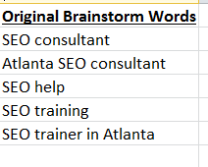
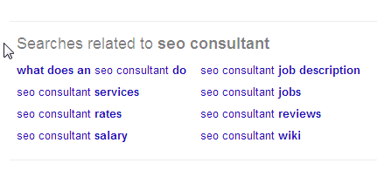
Keep Adding Words: Google Autosuggest

Slide 31
Phase 2: Verify the Data – Using Google’s Free Keyword Planner

Slide 32
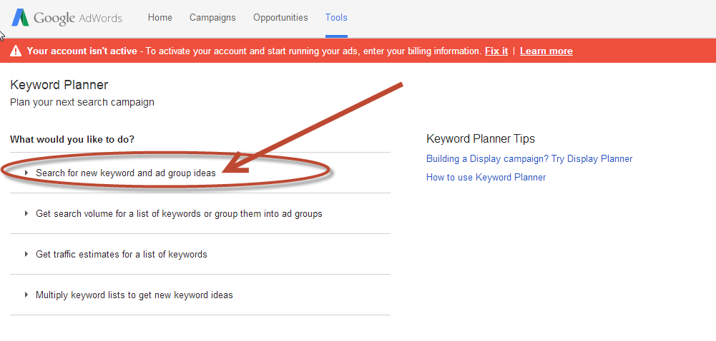
Google Keyword Planner
https://adwords.google.com/KeywordPlanner

Slide 33
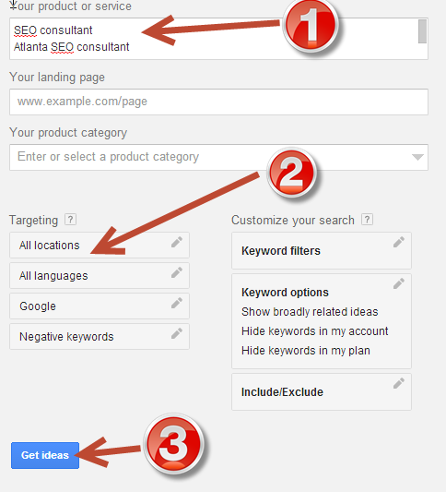
Notes:
Sort the search results by clicking on “Local Monthly Searches”

Slide 34
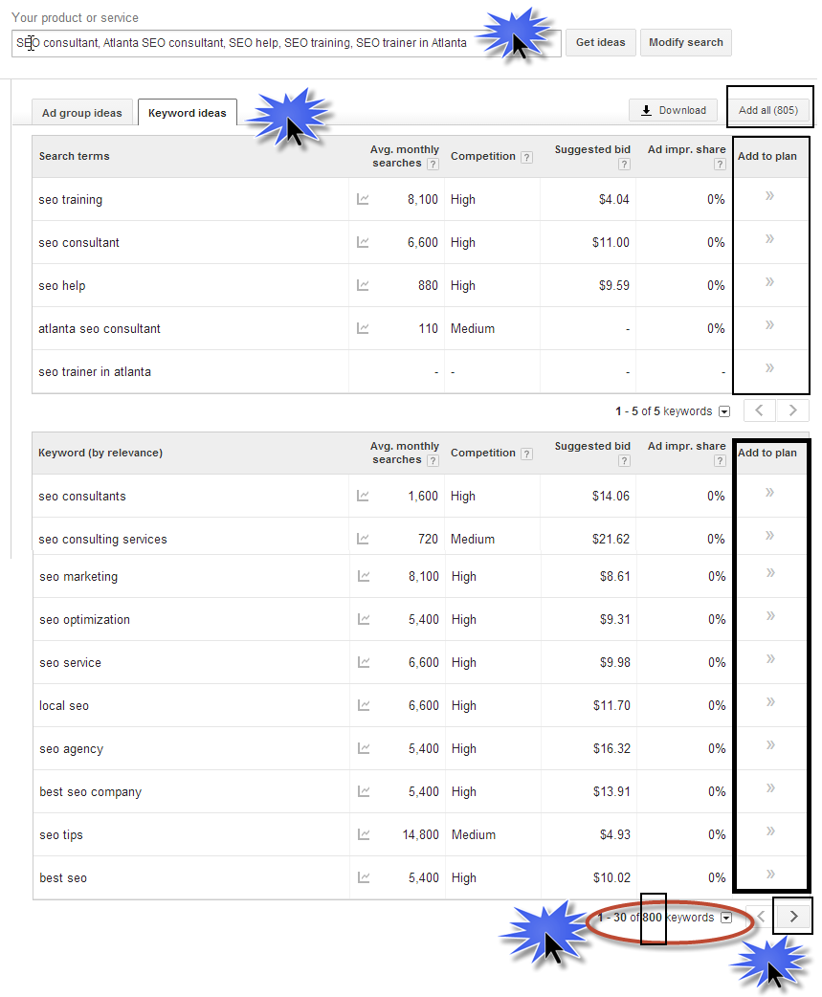

Slide 35
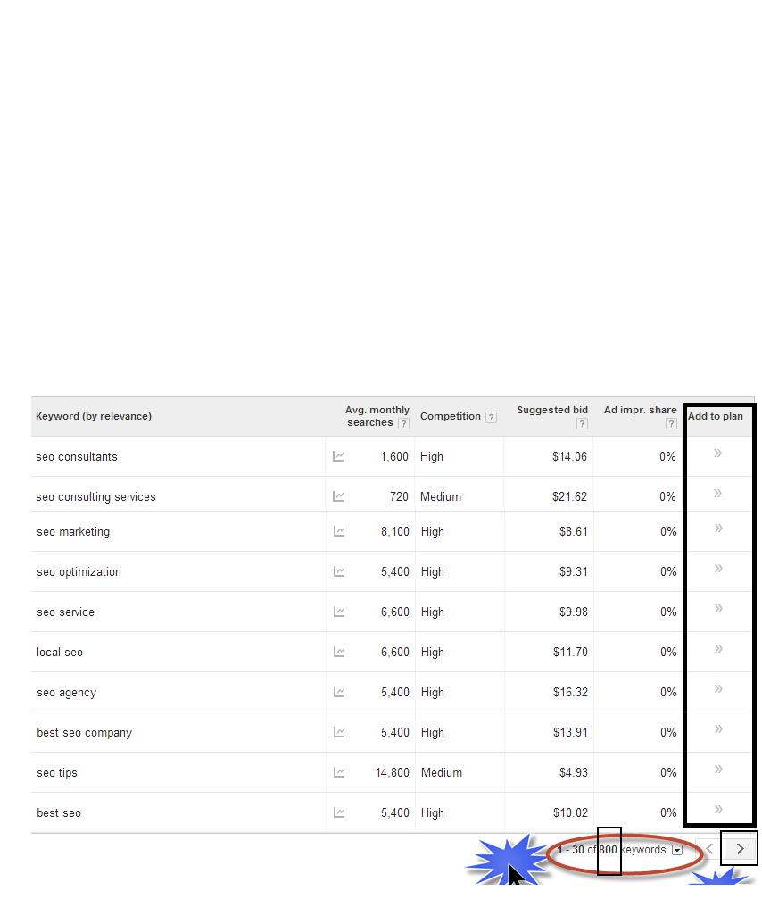

Slide 36
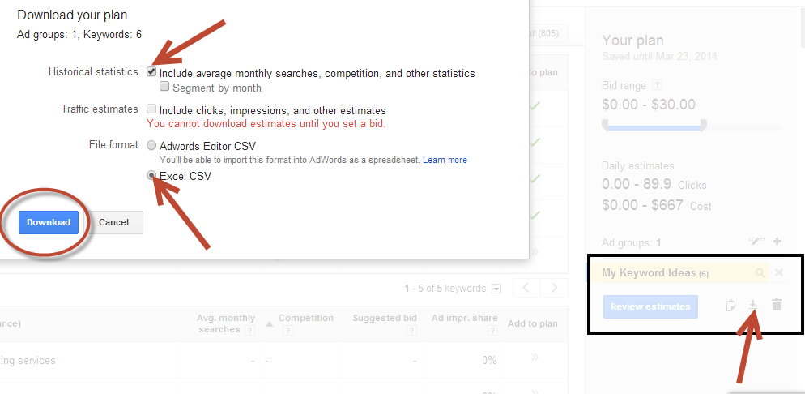

Slide 37
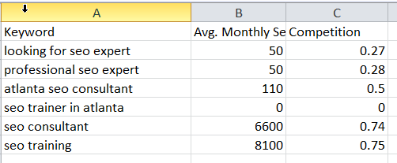

Slide 38
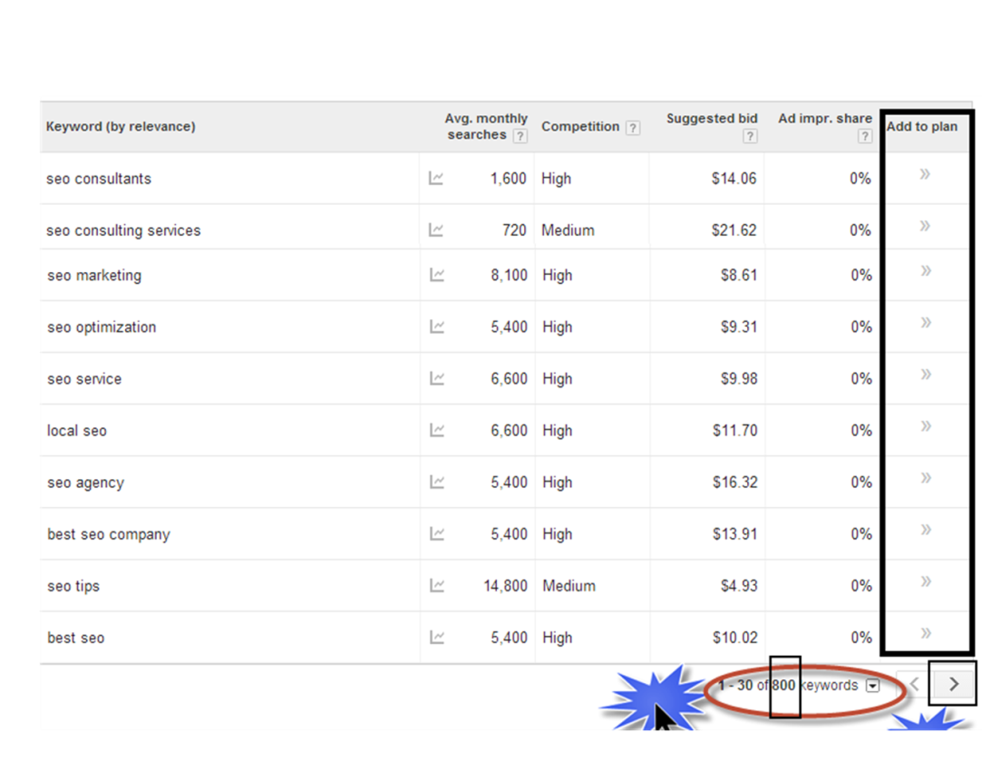
Review
1
2

Slide 39
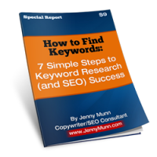
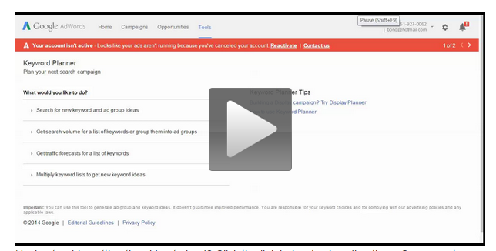
“How to Find Keywords” Free Report
Video: Keyword Research with Google’s Keyword Planner
http://jennymunn.com/are-you-an-seo-beginner/
http://jennymunn.com/keyword-research-googles-keyword-planner/
“Where do I LOOK for keywords?”
“How do I know that I am using the RIGHT keywords?”
“Why am I not RANKING for my keywords?”
Step-by-step instruction plus screenshots training packet
Jenny Munn

Slide 40
Keywords Need a Home
Website Pages
General/Broad pages: Home, About, Services, Contact
Content
Specific: specific blog posts, articles, press releases, etc.

Slide 41
Keyword Research Questions? Takeaways?
Master KW spreadsheet
Keywords for social media
Working with clients – should keywords be determined?
Average amount of time – 20-30 minutes for a blog post…2-4 hours…

Slide 42
Analytics: How Do I Know if My SEO Is Working?

Slide 43
Analytics Goals
Analytics is like drinking from a fire hose – we can’t learn it all
I want to show you the metrics that matter to real SEO
Help you build that muscle

Slide 44
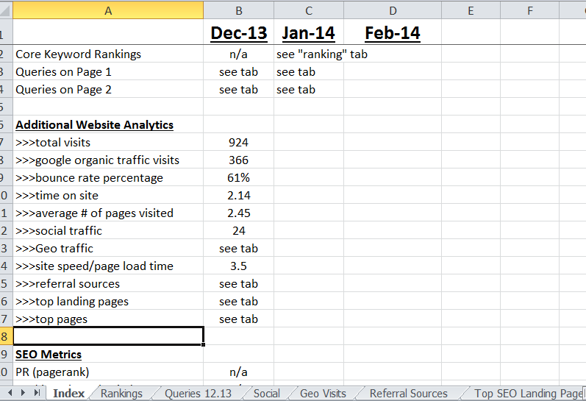
Ongoing Analytics Tracking

Slide 45
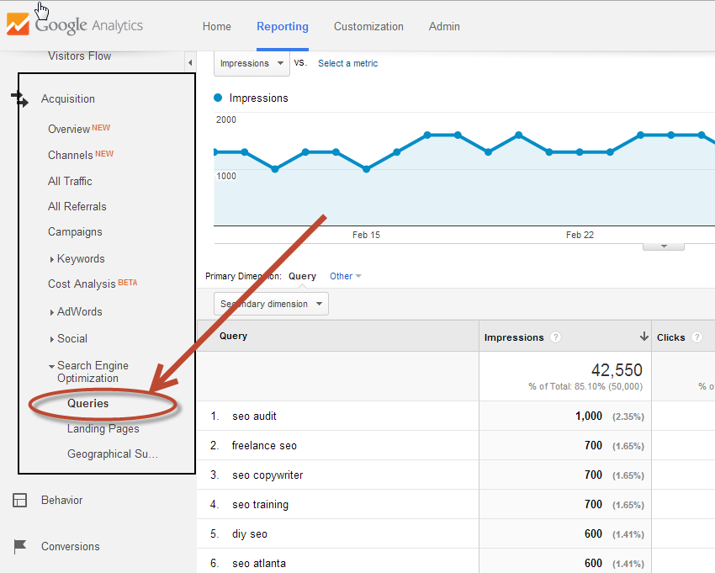
SEO Report in Analytics

Slide 46
Let’s Turn to Google Analytics LIVE

Slide 47
SEO, Google Analytics, Keyword Research Takeaways
Goals in GA: resource will be provided TBD

Slide 48
10-Minute Break Come Back: __12:20 EST_

Slide 49
On-Page Optimization: SEO Copywriting and SEO Blogging

Slide 50
Goals:
Get more comfortable understanding how to work keywords in the copy
Become comfortable with hearing foundational on-page terms: title tag, title tag, title tag
Build that muscle a little stronger

Slide 51
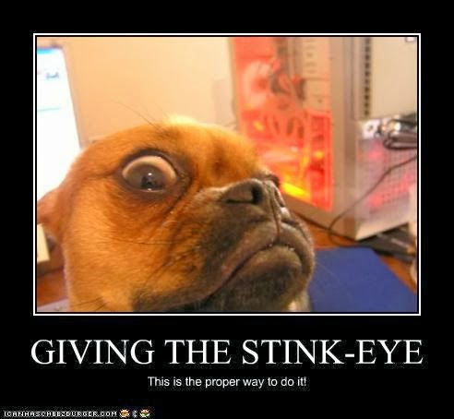
Content
Any content piece with its own URL can be optimized for its own keyword (website landing page, individual press release page, blog post, etc.)
QUALITY Content is the bigger part of SEO nowadays
Balance ENGAGEMENT:
Great content and copy
Does anyone see this page as a good resource
How much time are they spending on the page
Findability:
SEO best practices
Working in the keyword

Slide 52
On-Page Optimization Overview
2 parts:
“Behind” the Page: title tag, meta description, alt text
Front of the page: copy, H1, image, formatting, internal links, etc.

Slide 53
“Behind” the Page: Title Tag

Slide 54
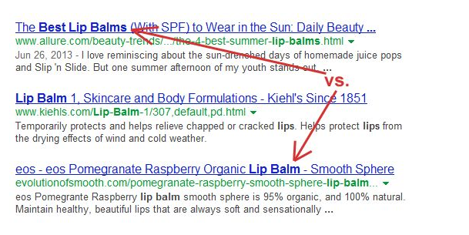
“Behind” the Page: Title Tag & Meta Description
In Serps….
How people determine whether or not to click on your results
Title Tag: 60 characters, front load keyword

Slide 55
Meta Description
The size of a tweet – 120 characters
1-2 sentences that succinctly summarizes what that page is about
Use engaging, descriptive language
ALWAYS include your primary keywords, secondary if you can – frontload when possible
Write unique descriptions for each page

Slide 56
SEO On Page Optimization Gone Wild
If you need career counseling, look for a professional counselor. Career counseling can help you in many ways. The first benefit of career counseling is finding a job quickly. Career counseling can also help you avoid making interviewing mistakes that cost you the job. When you need career counseling services, don’t hesitate to call the best career counselor in Atlanta.

Slide 57
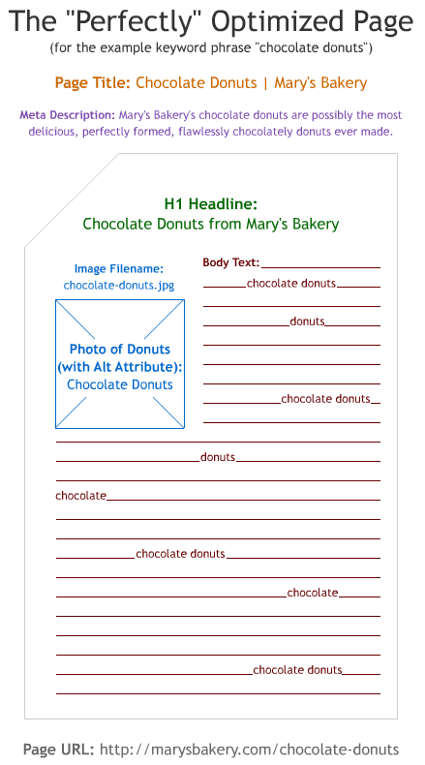
On-Page Optimization
On-page is just good, solid SEO copywriting
Good, ETHICAL on-page optimization has not changed in a number of years
Don’t be worried about the algorithms

Slide 58
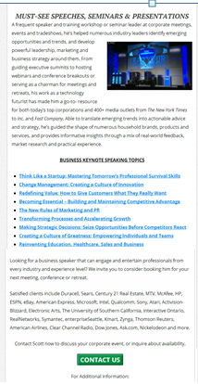
What Should a Page LOOK Like?

Slide 59
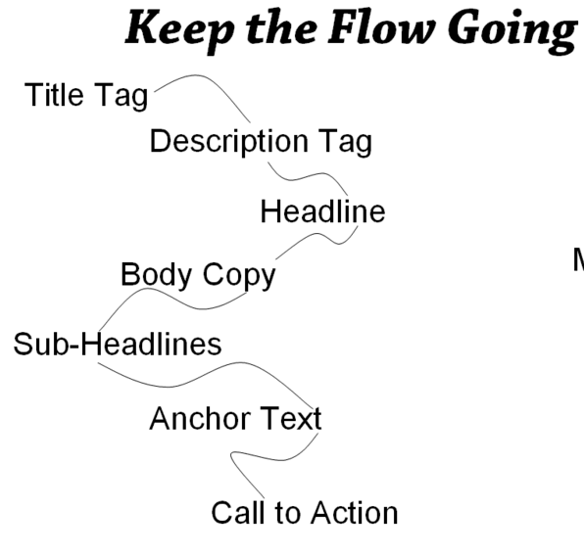
On-page SEO

Slide 60
On-Page Optimization Rule:
Always write for the reader!
NO exceptions

Slide 61
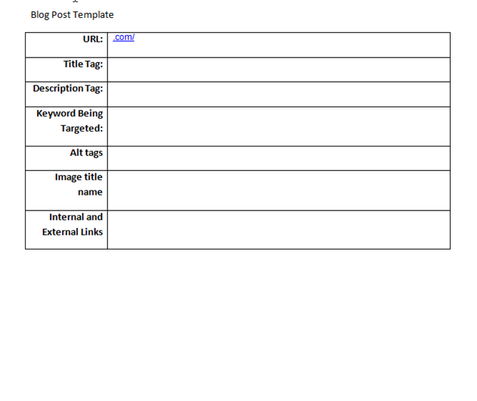
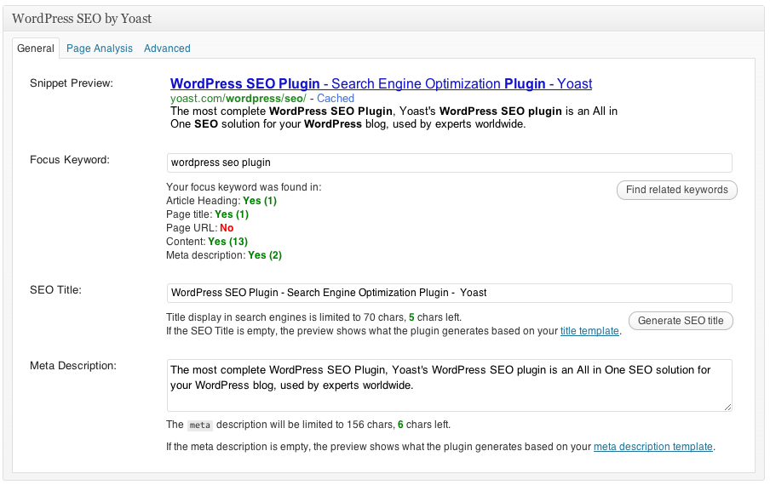
On-Page SEO Template

Slide 62
SEO Blogging

Slide 63
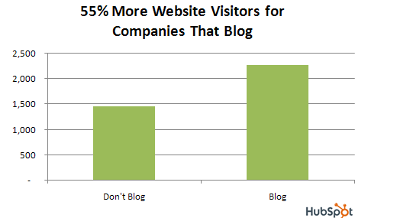
Blogging for SEO
More keyword opportunities
Google LOVES fresh content
Long-tail keyword opportunities
Better linking – internal and inbound
Hub of Your Content Marketing Plan
Social Media Fodder

Slide 64
SEO Blog Post Guidelines
Where to put keywords
Follow an editorial calendar
Follow the on-page template
Internal link
Images
Alt tag and image file name for images
Formatting page critical
Title tags/meta descriptions needed (template will help) – bake into the process of content creation
CTA – especially for “SEO” blog posts

Slide 65
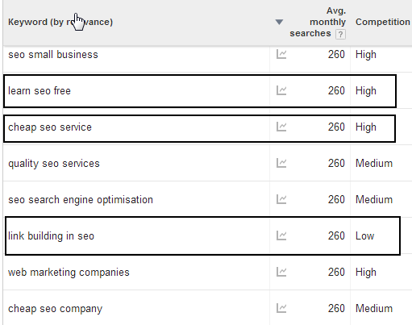
Idea: Create Blog Content Around Keywords

Slide 66
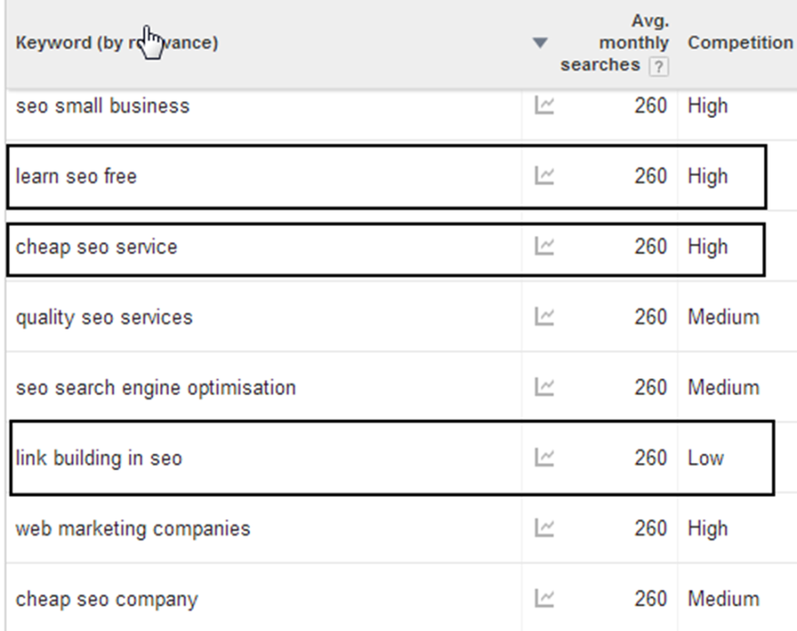
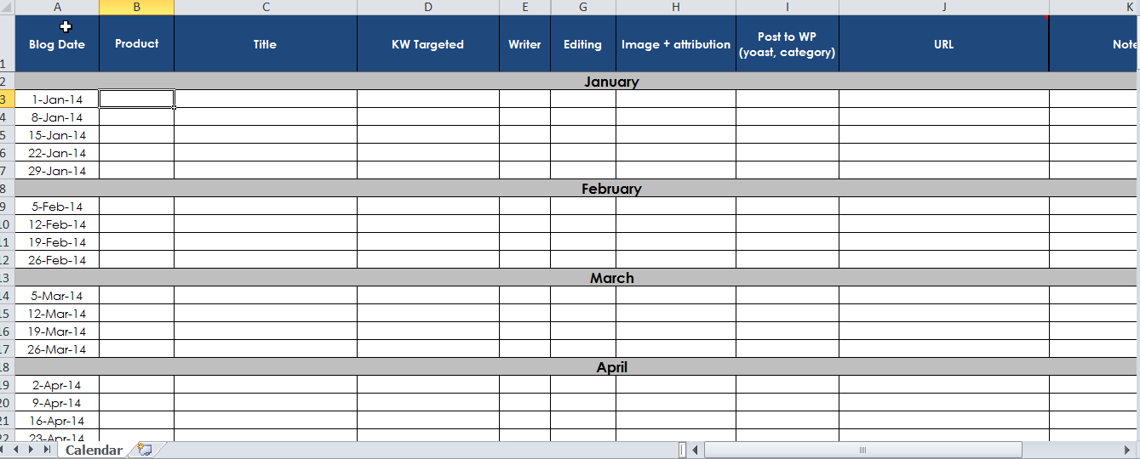
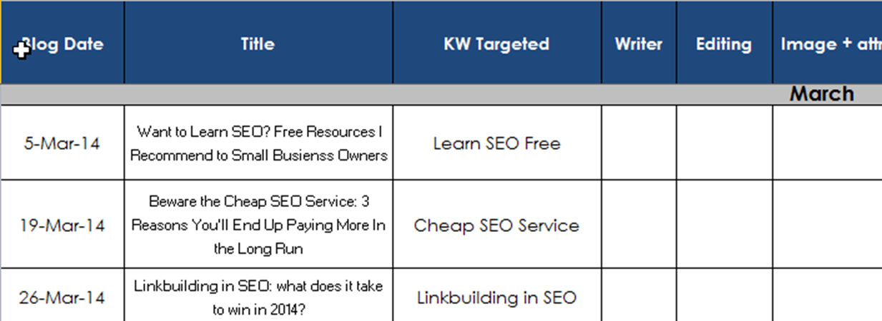
Integrate Keyword-Driven Posts into Your Editorial Calendar

Slide 67
SEO Blog Posts vs “Company” Blog Posts
Idea of integrating seo blog posts with what you want – NOT taking over
SEO blog takes take more effort to write – research and time will go into it but will get easier
Goal: 50% of posts should be SEO/optimized
Big part of ongoing SEO strategy

Slide 68
2 Type of SEO’d Blog Posts
2 types:
Start with content: find a keyword that fits your content
Importance of keyword research
Start with keywords: creating content around keywords we want to rank for

Slide 69
All Comes Back to the Master KW Spreadsheet

Slide 70
Linkbuilding and Social Signals

Slide 71
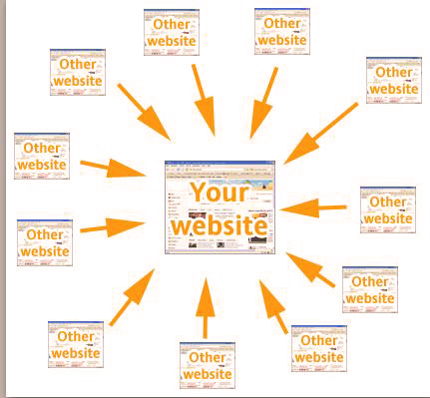
Off-Page SEO/Linkbuilding

Slide 72
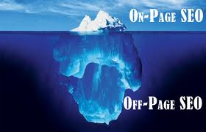
Off-Page SEO
Quantity used to be important - now it’s all about QUALITY
A link is a “Vote” for your site
Linkbuilding is one of the top reasons websites get penalized in Google, and that there are so many algorithm updates.

Slide 73
2013 Concept: Linkbuilding
You can’t live in a bubble
Make news or make friends
Think of linkbuilding as “community building”

Slide 74
Blogs Get More Link Love

Slide 75
Back Links in Real Life
Let’s visit Jama and “competitor” links…

Slide 76
Linkbuilding: Your Turn
What things are you doing in your everyday business?
Without being obnoxious, keep link opportunities *always* in the back of your mind. “Think of the Link.”
Ex: Out of 44 speakers at WordCamp Atlanta 2013, how many linked to their site in their bio? 11
Ex: Are you a member of an association? Have you filled out your online profile? With a hyperlink back to your site?

Slide 77
Social Media Optimization
Social signals are becoming more important
Trust, authority, and engagement
Direct links (from your social media profiles and activity) and indirect links from your content getting promoted by other users
Another way to drive awareness, drive traffic, get your content FOUND (in turn which sends good signals to Google, can generate links and prospects)

Slide 78
5-Minute Break? Come Back: ____

Slide 79
Overview and Recap

Slide 80
SEO Is Like the Legal Profession…

Slide 81
Recap of Training
History of “Traditional” SEO vs SEO in 2015
Core Fundamentals of SEO:
Keyword Research
Google Analytics
On-Page Optimization
SEO Blogging/SEO Content
Linkbuilding/Social

Slide 82
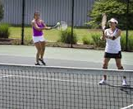
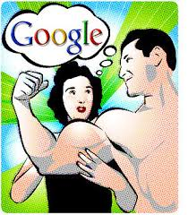
2 Things It Takes To Grasp SEO
SEO is like Tennis. Reading and learning will only take you so far.
Build Your SEO Muscle. You have to hear this stuff 10x to sink in.
Notes:
You can get stuck in the research phase FOREVER and it will stall your SEO efforts

Slide 83
Resources: SEO Content Page Template

Slide 84
Resources: “Master Keyword” Spreadsheet

Slide 85
Resources: Workbook

Slide 86
SEO’s Role – Awareness, Qualified Traffic
However: nurturing and a website marketing plan is key to conversion and results

Slide 87
Next Steps
Start integrating best practices into your routine
If clients need help, an audit will help prioritize, identify weaknesses and look for opportunities

Slide 88
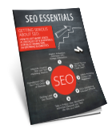
“How to Find Keywords” Free Report
“SEO Essentials: Getting Serious About SEO” Free Report
jennymunn.com
Downloads Go Here: jennymunn.com/seo-bootcamp-templates/
Jenny Munn

Slide 89
Takeaways
SEO is NOT “Black Magic”
You have to work the fundamentals
Marathon, not a sprint
Learning is in the doing
SEO is absolutely worth it
Notes:
It’s ABSOLUTELY WORTH IT

Slide 90
Questions/A-Ha’s/Takeaways
Blog post: Yoast plugin – tags, categories, etc. AHA
Mimi – keywords having a HOME
Which ones are the best to use? Use for blogs!
Free tool for Domain Authority -> DA of a website
Basics of GA – basics report
Jenny Munn
SEO Consultant/Trainer www.JennyMunn.com Jenny@JennyMunn.com Twitter @JennyMunn
Stay in Touch!

